Slide 1
Track / Module name
Day XX: Requirement Analysis
Notes:
Additional Materials or Pre-session prep tasks:
Approximate module duration: 3 hours

Slide 2

Welcome!
About me
Lead Technology & Innovation with a passion to get to the fundamental patterns in different topics
Passions
Challenging problems & patterns
Structuring the un-structured – Engineering roots
Pet Peeves
Ambiguity
Lack of clarity
Mukundan Sundararajan
Notes:
Purpose:
Approximate Duration:
What to cover:

Slide 3
01
Qualified Requirements – A Test Specialist’s role
02
Requirements elicitation
03
Modelling of Requirements
04
Requirements review
Notes:
Purpose:
Approximate Duration:
What to cover:

Slide 4
After completing this module, you should be able to:
Understand the requirements document and prepare testable requirements
Understand the various models/documents used in requirements analysis
Prepare test scenarios based on the validated requirements
Understand the linkage between the requirements and the CTD Model
Notes:
Purpose:
Approximate Duration:
What to cover:

Slide 5
01
Qualified Requirements – A Test Specialist’s key role
Notes:
Purpose: To go over the objectives of this topic
Approximate Duration: 2 minutes
What to cover:
• Tell the participants that upon completion of the topic, they should be able to:

Slide 6
Testing
What is a requirement?
According to the Business Analysis Body of Knowledge (BABOK),^{[3]} a requirement is:
- A condition or capability needed by a stakeholder to solve a problem or achieve an objective.
-
A condition or capability that must be met or possessed by a solution or solution component to satisfy a contract, standard, specification, or other formally imposed documents.
- A documented representation of a condition or capability as in (1) or (2).
Source - Wikipedia
It is very important to express these requirements as consistently and completely as possible to make sure the system under development is correctly addressing the characteristics and behavior needs of the stakeholder. Thus, analysis of the requirements is critical to the later phases of the development. Such analysis should identify the characteristics and behaviors.
Notes:
Purpose:
Approximate Duration:
What to cover:
The linkage of software application’s characteristics and behaviours to requirements is key to understand the CTD Model

Slide 7
What is requirement analysis?
The process of studying and analyzing the customer and the user needs to define, document and maintain the requirements.
Objectives
Understand the requirements and identify specific requirements (what to build)
Identify the project scope/boundary ( what will not be done)
Remove inconsistencies /ambiguities in requirements and document the requirements
Link the requirements to the underlying model of the software system
Notes:
CTD is a good model of the software system.
Attributes and rules – relation to the variable and logical/mathematical rules

Slide 8
Common pitfalls in Requirements Understanding
Lack of Clarity in Defining Criteria for Success – Acceptance criteria
Customers don't (really) know what they want
Lack of or Over Communication by Clients
Stakeholders can have Conflicting Priorities
Communication gaps exist between customers, engineers and project managers
Requirements change during the course of the project
Implicit requirements assumed by the client
Notes:
Add personal stories for some of these:
How GHs gained respect in my teams. Flag issues early, provide valuable insight
Bring in solid engineering principles to support questions – “have data and a good story”

Slide 9
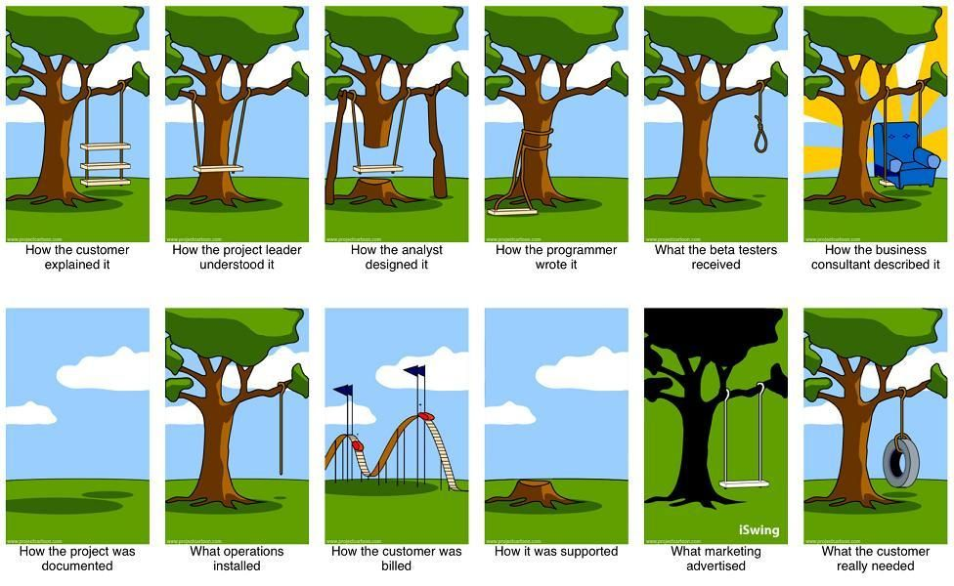
What happens due to issues in Requirements Understanding
Notes:
Customer
Business analyst
Tester
Developer
Project manager
Final product

Slide 10
Activity 1:
Participants will be shared a single requirement
Initially trainer shares it to one participant
Each participant transfers what he heard to the next person
Final participant reveals the requirement
Observation
Team to understand that requirements are perceived in each person’s knowledge and exposure
Documentation and clarification are key to requirement understanding
Notes:
Approximate Duration: 5 minutes
What to cover:
Share the activity guide with the class.
Say that this activity will be performed individually.
Tell the learners to follow the steps
Requirement - ( Build a software to handle cash and credit card for employee base who are part of the finance team. Employee payables team to use this in addition to employee receivables team.)
Go around the class to support the participants.
After the stipulated time, ask one participant per table to showcase their output.

Slide 11
Cost of Poor Requirement
Missing, inflexible, misunderstood, and ambiguous or poorly written requirements often lead to project failure and inflated costs:
"Poor requirements" are often cited as a leading cause of software problems (Standish Group 1994).
Requirement errors are not expensive to fix during the requirements process. However, if they escape
into design, code or test, they are the most costly errors to correct.
The IBM Orthogonal Defect Classification (ODC) data for many projects supports the idea that low
-quality requirements result in missing functionality discovered later in the software development cycle.
Many teams work in a geographically distributed development environment. Accurate written requirements are especially important when members of the same development team are not in the same location and the opportunities to clarify information in real time are reduced.

Slide 12
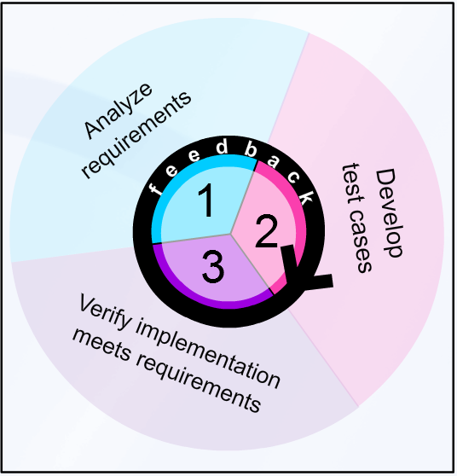
Role of Testers
Software developers and testers both have a role and a responsibility, in the overall quality of requirements.
developers + testers + Collaboration/review of requirements => improve quality of the requirements
software ->deliverable from the software development process
testware ->deliverable from the testing process
Activity | Artifact from Tester | Expected outcome
Joint Requirements review | Implicit, ambiguous, defective requirements | Defects raised and resolved on requirements – Shift left
Joint Design review | List of requirements (modal statements) | Map of requirements ←→ code Gaps or misaligned software defects identified – Shift left
Test Readiness Review | Test plan, test cases | Preparedness to commence test execution
Notes:
Software developers and testers both have a role and a responsibility, as well as a stake, in the overall quality of requirements.
Software developers can obtain feedback and analysis of requirements from testers who use the requirements to develop test cases that verify that the implementation meets the requirements.
By jointly working on requirements, developers and testers can improve the quality of the requirements used in developing both the software and testware. (Just as software is the deliverable from the software development process, testware is the deliverable from the testing process.)

Slide 13
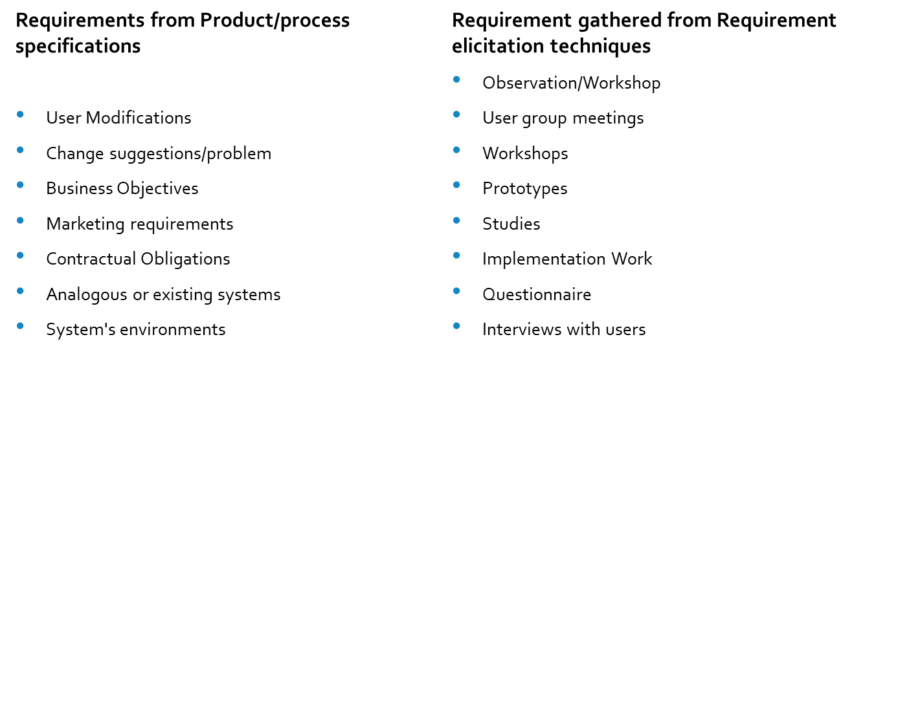
Sources of Requirements
Notes:
Examples for trainer note
Contractual Obligations – GDPR implementations
System’s requirements – Upgrade of software version
User/Usage modifications – buttons on touch screen must be large or have gaps
Change suggestions – Alphabetical or highest use?
Business Objectives -
Marketing requirements – owner’s pride
Analogous systems – Like a Ferrari

Slide 14
Types of Requirements
Business Requirements
Market Requirements
Functional Requirements
Non Functional Requirements
UI Requirements
Vision Document -> Business Requirements
Use Case Document -> User requirements, quality attributes
SRS -> System requirements, non functional requirements, constraints, quality attributes
Notes:
Business Requirements are captured at business level, while Marketing requirements are done at higher level which drills down to business requirements.
Functional, Non functional and UI requirements are defined at user level. Non functional requirements is based on non functional features such as scalability, performance, etc,

Slide 15
Identify Stakeholders
Acquirers of software product
Suppliers of software product
Other Stakeholders
  Legal
  Market
  Sales
  Government or regulatory agencies
Notes:
Trainers could begin with who is a stakeholder

Slide 16
Steps to Perform Requirement Analysis
Understand the problem
Apply Requirement elicitation techniques to gather requirements
Develop Prototype
Document the source and reason for each requirement
Use multiple views of requirements
Rank Requirements
Work to eliminate Ambiguity
Determine implicit requirements and document them explicitly

Slide 17
Team Exercise
Sl No | Requirement statement(s) | What is the issue?
1. | -“ Customer RD” field will be an optional field with an alphanumeric character limit of AN64. - $app needs to validate Customer Route Distinguisher (Customer RD) to have A numerical number X < 65000.
2 | $app will allow user to enter Customer RT in a text box and display a save button in the Popup window and rest of the flow will be existing flow.
3 | Scope : AVPN MACD’s • “Search Filter” will also be disabled for other AVPN MACD’s
4 | If user doesn’t enter while upgrade, ADOPT or any downstream system will not validate and System will automatically assign WAN IPV4.
5 | User should be able to do " Change Bandwidth" MACD action for Port Level Cos sites.
6 | For all Sites in A Solution that's already created in ADOPT before this Project Deploys we need to default the Performance Group to "Premium".
7 | The “Mode” will define which table and full dump from $app2
8 | This prompt will be an informational messages and will not block the user from any task. This is BAU for other Screens in $app.
9 | A template (either System template or user defined template) is applied first with the PG populated.
10 | The new account requestor shall be a major and above the age of 20.
Notes:
Incorrect – Defective requirement
Implicit
Ambiguous
Implicit
Correct requirement
Not a definitive requirement
Correct requirement
Implicit/Ambiguous
Not a definitive requirement
Major in most countries is 18 years and above – so defective requirement

Slide 18
Spot Quiz
01
Identify stakeholders of requirements
A
Developers
B
Testers
C
Managers
D
Contractors
Notes:
Approximate Duration: 2 minutes
What to cover:
Ask the participants the question on the slide. Treat the question as a poll. Ask them to raise their hands based on their answer.
The correct answer s are Options A, B, and C
Option D is incorrect;
Contractors are part of the project implementation phase. Hence, it will be the developers, testers, managers, designers, PM, customers who will interact and identify the requirements

Slide 19
Spot Quiz
02
Which of the following is not a type of requirement
A
Functional
B
Security
C
Performance
D
Traceability
Notes:
Approximate Duration: 2 minutes
What to cover:
Ask the participants the question on the slide. Treat the question as a poll. Ask them to raise their hands based on their answer.
The correct answer is Option D
Option A is correct;
Option B is correct;
Option C is correct;
Option D is incorrect;
Functional, security and performance are types of requirement. Traceability helps to understand the mapping between the requirements to testing.

Slide 20
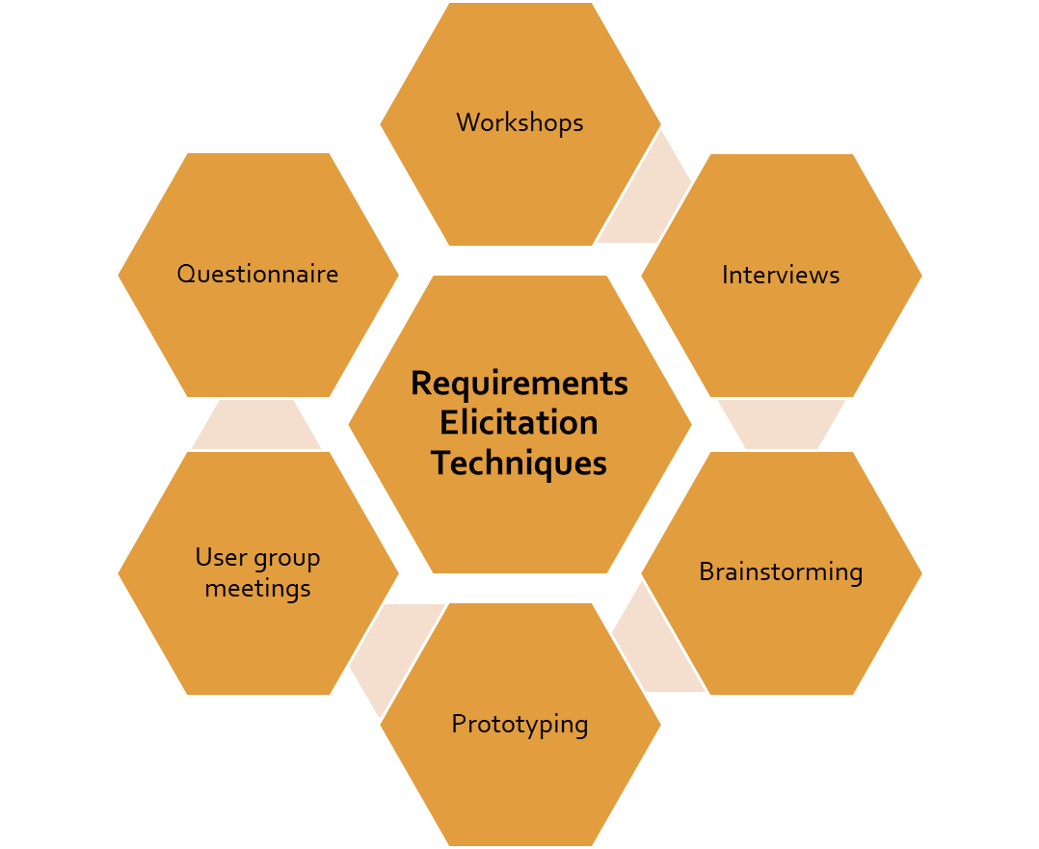
Requirements Elicitation Techniques
Gather stakeholders for short but intensely focused period to brainstorm on ideas.
Gather stakeholders for short but intensely focused period to brainstorm on ideas.
Strong medium to gather/refine requirements
Structured interviews , Non Structured, Written , Oral, One-one, Group
Predefined set of questions and options.
Source of idea generation and idea reduction
A partial implementation of the product/system to better understand the requirements
Prototype the requirements that are poorly defined or understood

Slide 21
Other Requirement Elicitation Techniques-
Facilitated Application Specification Technique
Meeting between customer and Software developers
Agenda defined with rules for participation
Facilitator acts as a controller
Identify problems, propose solutions, specify preliminary requirements
Requirements are refined and once agreement established, requirements are finalized

Slide 22
Other Requirement Elicitation Techniques-
Quality Function Deployment
Quality Function Deployment (QFD) is a process and set of tools used to effectively define customer requirements and convert them into detailed engineering specifications and plans to produce the products that fulfill those requirements.
Translates the needs of the customers into technical requirements for software
Requirements are classified as Normal, Expected and Exciting

Slide 23
Spot Quiz
03
FAST Stands for
A
Facilitated Application Security Technique
B
Functional Application Specification Technique
C
Facilitated Application Specification Technique
D
Functional Automation Sequential Technique
Notes:
Approximate Duration: 2 minutes
What to cover:
Ask the participants the question on the slide. Treat the question as a poll. Ask them to raise their hands based on their answer.
The correct answer is Option D
Option A is correct;
Option B is correct;
Option C is correct;
Option D is incorrect;
Expansion of FAST is Facilitated Application Specification technique

Slide 24
Requirement analysis – prioritization, remove ambiguity
Prioritize requirements
Categorize requirements into
1) essential
2) useful
3) desirable
Characteristics of Good requirements
Unambiguous
Complete
Verifiable
Consistent
Understandable
Modifiable
Traceable
Independent
Concise
Testable
Validate the requirements after prioritizing and using the various requirement analysis techniques, ensure the characteristics of good requirements are met.

Slide 25
Modelling
It’s useful for figuring the functional requirements of a system.
Reduce ambiguities and gaps in requirements
Use the models as basis for requirements to tests.
Use Case modelling, data Modelling and UML(Unified Modelling Language) are examples of requirements modelling methods.
Use Case Model - a use case is a list of actions or event steps typically defining the interactions between an actor and a system to achieve a goal
Data Model - This data model is a conceptual representation of. Data objects
UML - A UML class diagram is not only used to describe the object and information structures in an application, but also show the communication with its users.UML diagrams describe the boundary, structure, and the behavior of the system and the objects within it.

Slide 26
Models
A use case is a description of system behavior in terms of sequences of actions. A use case should yield an observable result of value to an actor. An actor is someone or something that interacts with the system. [5]
Functional requirements specify the behavior of a system. They specify the actions that a system must be able to perform, without considering physical constraints. IRUP recommends that you capture functional requirements in use cases and, optionally, a use-case model. [5]
A use-case model describes a system's functional requirements in terms of use cases. A use-case model provides a visualization of all use cases and actors for the system and their relationships. [5]
Requirements that are not related to capability—such as usability, reliability, performance and supportability requirements—are sometimes called nonfunctional requirements. Many requirements are nonfunctional and describe only attributes of the system or attributes of the system environment.

Slide 27
Evaluating a Use-Case Model
These steps for evaluating a good use-case model are based on Guidelines:
Use the customer requirements to verify that you have identified all actors and use cases.
Check that the use cases and the actors are described briefly.
Be sure that you identify a subset of use cases to detail in each iteration.
Avoid functional decomposition. Symptoms include:
  "Small" use cases, meaning that the description of the flow of events is only one or a few sentences
  "Many" use cases, meaning that the number of use cases is some multiple of a hundred, rather than a multiple of ten
  Use-case names that are constructions like "do this operation on this particular data" or "do this function with this particular data." For example, "Enter Personal Identification Number in an ATM machine" should not be modeled as a separate use case for the ATM machine, since no one would use the system to do just this. A use case is a complete flow of events that results in something of value to an actor.
Use the use-case model to answer questions like:
  What is the context of the system?
  Why is the system built?
  What does the user want to achieve when using the system?
  What value does the system add to the users?
Check that the glossary or domain object model is kept up to date with the use-case model.

Slide 28

Use Case Approach
A meaningful piece of system functionality
It treats business processes as use cases of the business
Use case
An Actor
Use case
An Actor
Notes:
An actor represents a type of user that interacts with the system. An actor can be a person or another system.
A use case defines a goal-oriented set of interactions between external actors and the system under consideration. The following are the types of actors in a use case:
A primary actor is one having a goal requiring the assistance of the system. Primary actors are central to the execution of a use case.
A secondary actor is one from which the system needs assistance. For example, a secondary actor might provide a service in the use case.

Slide 29
Use Case Approach
A use-case model describes a system's functional requirements in terms of actors, use cases, and relationships between these elements.
An actor triggers a use case with a particular goal in mind, and the use case is completed successfully when that goal is satisfied. It describes the sequence of interactions between actors and the system needed to deliver the service that satisfies the goal.
Thus, use cases capture who (actor) does what (interaction) with the system, for what purpose (goal), without dealing with system internals. A complete set of use cases specifies all the different ways to use the system and therefore defines all behavior required of the system.
Use cases include the following:
Preconditions
The interaction between an actor and the system in terms of input, computation, and output statements
Associations and relationships
Exceptional conditions

Slide 30
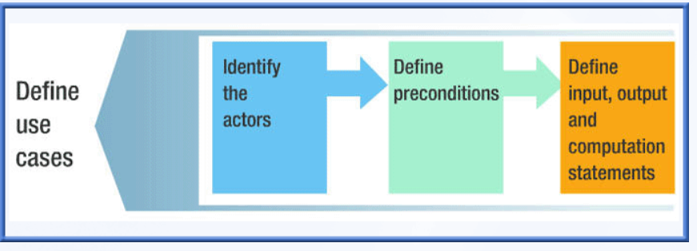
Use Case Statements
Here are four types of statements that can appear in the flow of events:
1. Input: States that information flows from an actor into the system. Input statements have this form:
actorName [enters|selects] information
2. Computation: States that the system performs some computation and update of state based on the input entered earlier. Computation statements have this form:
systemName[creates|computes|updates|deletes|selects]information
3. Output: States that some information flows from the system to an actor. Output statements have this form:
systemName[displays|returns] information to actorname
4. Exceptions: States the possible errors that you could encounter in executing the use case and what should happen. Exception statements have this form:
exception condition action
where the condition describes what causes the exception, and action is one or more of the input, computation, or output statements

Slide 31
Use Case Diagram
Use cases also have statements that specify what happens in an interaction with the system, without saying how it happens.
A flow is a sequence of statements that specifies what happens in a use case. Flows are defined using the three statement types: input, computation, or output.
Relationships are the connections between and among use cases and actors. They can relate actors to actors, actors to use cases, or use cases to use cases. There are two types of relationships: generalization relationships and association relationships.
Use-case diagrams are Unified Markup Language (UML) diagrams that represent the principal elements discussed previously: actors, use cases, associations, and relationships.
A use-case diagram does not show complete use cases. It shows only a high-level widget representing the use case, but the use case is detailed and presented in the flows defined for the use case.
Notes:
A use case with a high level of detail often skips a lot of information and describes the system at an abstract level. These use cases are most useful early in the project.
A use case with a medium level of detail describes things from the user's perspective. These use cases specify what the system does without specifying how it does it. This is a common, and generally useful, level to work with.
A use case with a low level of detail includes detail specific to the implementation. Low-level use cases are not necessarily helpful during the analysis stage when implementation choices are still being explored.

Slide 32
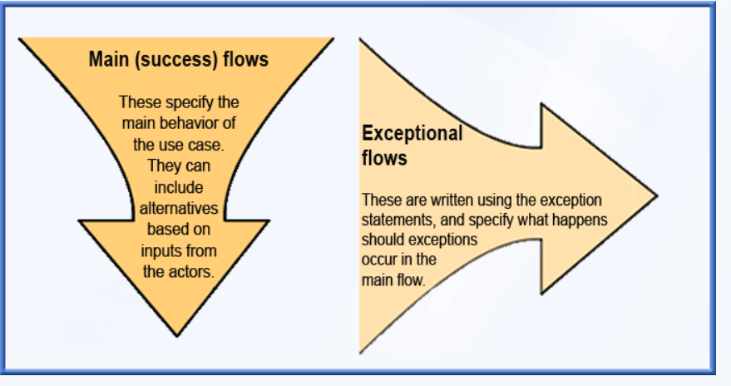
Events
Basic Event
Alternative Event
Any flow of events—basic or alternative—that results in a successful outcome is called a main flow.
You can use alternative flows to capture what happens if an exception occurs. In this case, the flow is called an exceptional flow.

Slide 33
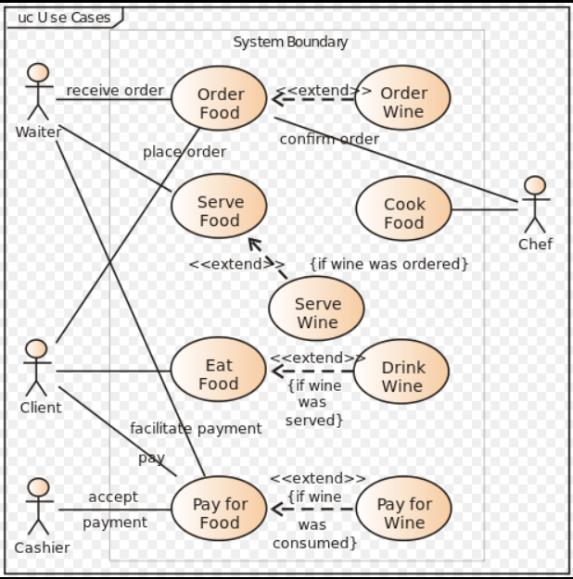
Example Use Case Diagram
Notes:
Use the use case diagram to collect the requirements. Can be used as an example to explain about the use case to requirements flow.
Recreate the diagram
Food example

Slide 34
Best Practices of Requirement Analysis
Request the requirements document from the developer you work with
Attend design reviews for the features you will test
Participate in general design reviews and for your assigned features

Slide 35
Modelling Techniques
Functional View
Architectural View
Mathematical View
  Mind Map
  DFD diagram
  Architecture diagram
  Interaction diagram
  CTD
Notes:
Refer to slide 24

Slide 36
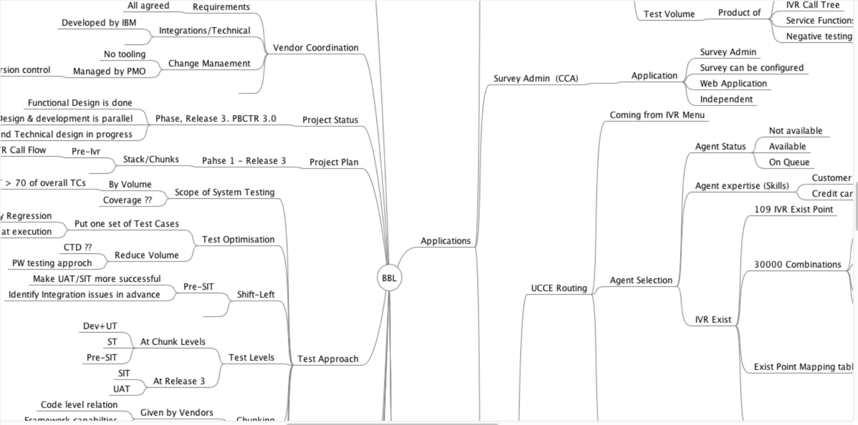
Mind Map
A pictorial representation of thoughts and ideas…in this case requirements.
Benefits
Is to provide overall picture of the subject in a single picture.
Generate more creative ideas and options
Is used to categorize and organize information
Maintain the focus of information
Notes:
Keep the screenshot as it is

Slide 37
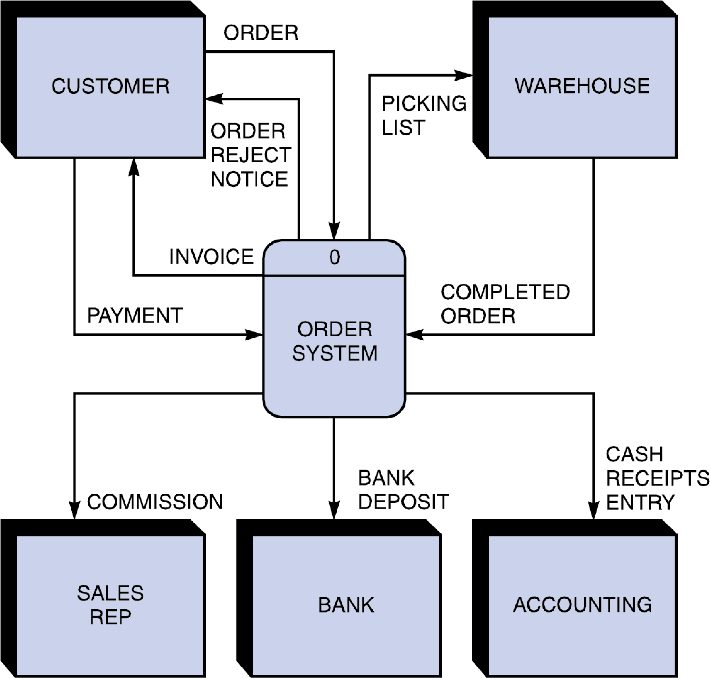
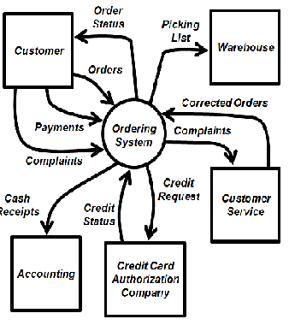
Context flow diagram
A system context diagram (SCD) in engineering defines the boundary between the system, or part of a system, and its environment, showing the entities that interact with it. This diagram is a high level view of a system. It is similar to a block diagram.
A context diagram will help reveal omissions and errors in a business plan or business requirements so that any necessary corrections can be brought to light and addressed before a project is deployed
The goal is to get feedback from a project’s stakeholders and identify any missing pieces while the project is still in the discovery stage
It facilitates the discovery and/or confirmation of high-level events that trigger the process, including external entities that interact with project or process, inputs to and outputs from the project or process, and initial sub-process requirements.
Notes:
Flowchart recreate

Slide 38
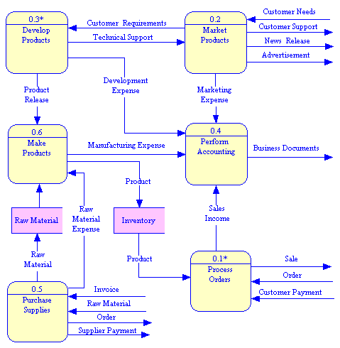
Data Flow Diagram
A data flow diagram (DFD) is a graphical representation of the "flow" of data through an information system, modelling its process aspects.
A DFD is often used as a preliminary step to create an overview of the system without going into great detail, which can later be elaborated.
A straightforward graphical technique which is easy to recognize.
It is beneficial for communicating existing system knowledge to the users
It aids in describing the boundaries of the system
It supports the logic behind the data flow within the system

Slide 39
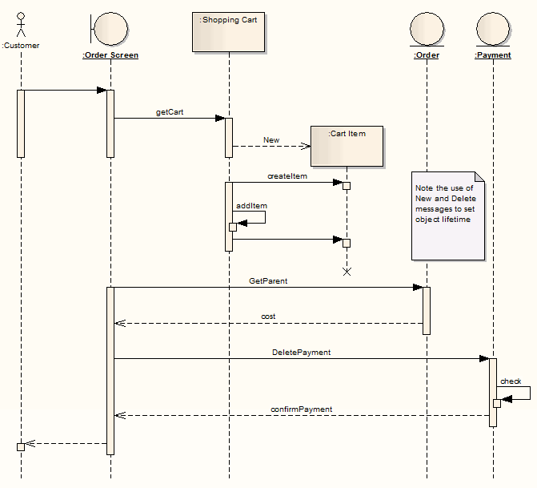
Sequence Diagram
A sequence diagram is an interaction diagram that shows how objects operate with one another and in what order. It is a construct of a message sequence chart. A sequence diagram shows object interactions arranged in time sequence.
Model and document how your system will behave in various scenarios
Validate the logic of complex operations and functions

Slide 40
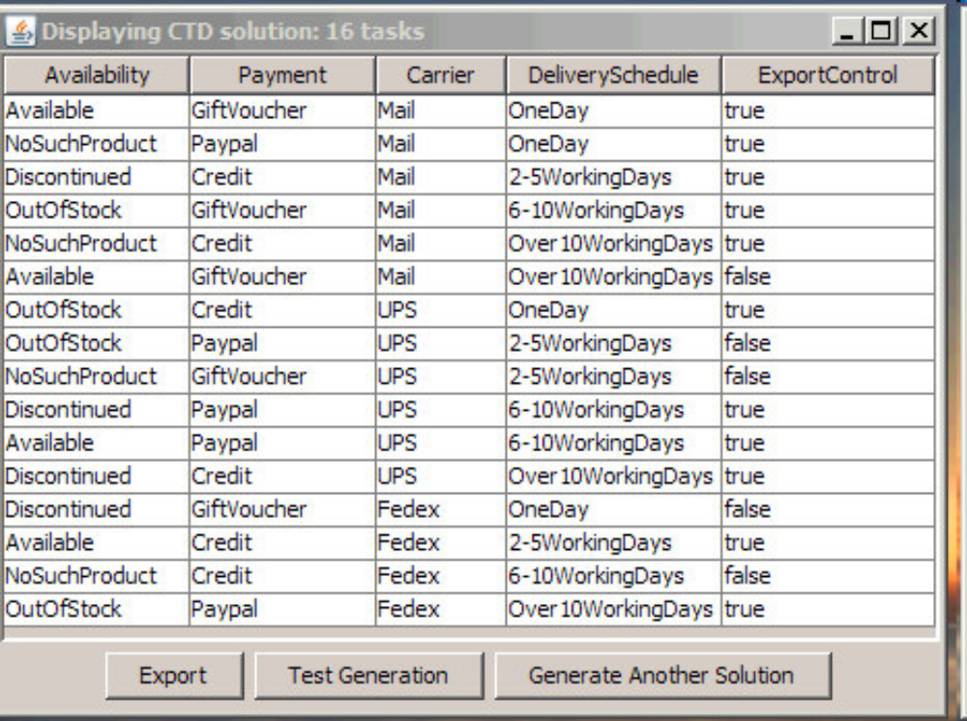
CTD Model
The CTD Model describes the characteristics and behaviors specified in the requirements through the attributes and constraints/restrictions.
It provides a mathematical model of the optimum number of test cases needed to verify the requirements.
Identify the parameters(points of variability) and the values for each of the parameters
Identify the constraints/restrictions to exclude combinations that cannot occur due to the specified business rules
Apply Cognitive principles on the input requirements document to determine the business rules and keywords
Establish the attributes and constraints

Slide 41
Class exercise – Determine attributes/business rules and constraints
Req ID | Requirement statement | Attributes/Constraints
Req003 | In case the e-mail address is not held in the system in valid format or has been end dated, the e-mail address field will be blank and a message will be displayed informing customer that we do not have an e-mail address recorded
Req004 | If an e-mail address was end- dated due to a hard bounce, a warning will be displayed notifying the customer that they will not receive e-mail notifications despite having selected e-mail as delivery method in their alerts unless a valid e-mail is entered
Req005 | The solution will pre-populate the customer’s mobile number if previously captured
Req006 | If a mobile phone number is not held in the system in valid format or has been end -dated, the mobile phone number field will be blank and a message will be displayed informing customer that we do not have a mobile number recorded
Req007 | If mobile number was end- dated due to a hard bounce, a warning will be displayed notifying the customer that they will not receive SMS notifications despite having selected SMS as delivery method in their alerts unless a valid mobile phone number is entered
Req008 | The solution will display a link to the Terms and Conditions for alert subscriptions
Notes:
Req003 and Req008: Do not have any constraining word, others have
Keywords:
Req003: valid format e-mail address field customer e-mail address
Req004:e-mail notifications valid e-mail
Req005:solution mobile number
Req006:phone number field mobile number
Req007:SMS notifications delivery method alerts mobile phone number
Req008:alert subscriptions

Slide 42
User Story
User Story:
As an $app user I want to test the following functionality for a PLC Site:
1. User should be able to do " Change Bandwidth" MACD action for Port Level Cos sites. Inventory should return the PLC indicator and user should be able to " Change Bandwidth" which is Port speed and Access Speed.
2. User should be able to Add or Change Multicast for a site supporting Port Level COS. Inventory should return the PLC indicator and user should be able to " Change Multicast" which is collected at VLAN Level.
3. 282163 Project should be HRID Conditioned. Only HRID conditioned user should be allowed to test the functionality .

Slide 43
Requirement Specifications
System Requirements - > Minimum, recommended
Other – Hardware, Software
Minimum – Requirements to make the system usable
Recommended – Requirements needed to make system perform optimally
Notes:
Requirements are classified as minimum and recommended. Recommended requirements can be optionally committed to the customer. They are only required to make the system perform better/optimal. Even then, it is better to discuss about these requirements with the stakeholders to confirm it’s logical inclusion to the software being built and to avoid any conflict/inconsistency.

Slide 44
Purpose of SRS
Acts as a base document to derive all requirements between the acquirer and provider of capability
Used for all pre and post validation and acts as a proof for any resolution
Helps to identify the component/module wise requirements
SRS acts as an interface between the various stakeholders – developers, designers, testers, business analysts, managers
SRS consists of Introduction to the product/software being built, lists all the product functions, interface requirements, system features, functional and non functional requirements, and other requirements.
Notes:
Software requirement specification

Slide 45
Validating the requirements
Requirements to be checked for Accuracy
or specifications to be correct, they should be:
Exact and explicit
Feasible
An accurate reflection of system objectives and marketplace requirements
If a requirement is not feasible, then there is no point in specifying it. A requirement, such as "any subsequent change in user requirements should be implementable in one day" is clearly impractical, but infeasibility can be quite subtle. Even simple-sounding requirements can prove technically difficult or expensive to implement. The statement "all screen transactions must be recorded simultaneously on hard copy" sounds innocent enough, but it proves infeasible if screen transactions involve the use of graphics or input by mouse, touch screen, joysticks, or voice.
Requirements to be checked for Correctness
Determining correctness might mean reviewing the process used to derive the requirements. Which users and customers were involved or interviewed? What techniques were used to derive and formulate the requirements? How are differences resolved? What approvals were obtained? Was there a review process with users and customers?
Requirements to be checked for Traceability
Traceability is one way to bound and verify the translation from a higher level set of requirements to a lower one. You should be able to trace objectives (requirements) to specifications, specifications to design, and design to code. You should be able to trace test cases to code, design, specifications, and requirements. You should be able to trace the requirements of the system or component to one or more business needs.
Requirements to be checked for Inconsistency
It is nearly impossible to test an inconsistent requirement because you don't know the expected result of an action. Contradictions and inconsistencies both lead to problems in later phases of system development because they are interpreted differently by different people.
Cases of contradiction can be obvious or subtle. Inconsistency with other documents is particularly hard to judge. Raise inconsistency issues to a level where they can be resolved.
Notes:
The requirements and specification documents are the key to telling you what the users and customers really want. But analysts can fall in love with the requirements document and believe it even when the customer says differently.
Things to look for in the wording of content:
Ambiguous words and descriptions
Inconsistencies and incompleteness
Unstated assumptions and implicit requirements
Clarity of expectation
Identification of precise criteria for judging correctness of functional elements
Definition of sample tests to clarify external behavior

Slide 46
Validating the requirements
Requirements to be checked for Completeness
Analyze all requirements for completeness; that is, determine if the system's scope has been clearly defined. Consider all of the following:
Backup or recovery facilities required
Future interfacing requirements
Diagnostic levels supported
Physical environmental levels, such as temperature
Performance and throughput
Reliability, maintainability, portability, and other "-abilities" that describe some property of the system
Documentation to be supplied
Resources needed for its operation, such as required levels of supporting software, hardware or firmware
Resources needed for its development
Requirements to be checked for Clarity
Good requirements documents are clear and easy to understand. Because of language, requirements often can be interpreted in many ways. Good requirements minimize the potential to have multiple interpretations.
Consider all the aspects of clear and unambiguous business writing requirements:
Write short sentences.
Use simple vocabulary.
Use active voice.
Use examples.
Organize materials into sections; label sections.
Keep information that belongs together in one place.
Cross-reference with care and accuracy.
Read it out loud to someone else.
required levels of supporting software, hardware or firmware
Resources needed for its development

Slide 47
Validating the requirements
Requirements to be checked for Testability
Can a test for the requirement be developed and executed? (Is it a definitive statement or a Modal statement (in NLP terms))
The key to is measurability. Functional requirements are often objective. The greater problem lies with nonfunctional and quality requirements and specifications.
A requirements document states what users expect from the system. The final system should fulfill that expectation. So it becomes crucial to be able to verify that the system satisfies user expectation. Make sure the requirement translates into something that you can test; don't wait until the system has been built.
The only way to get a testable requirement is to quantify requirements as much as possible. If you've quantified the requirement, then there is a definite point at which the user can say that it has (or has not) been met. Even if you cannot precisely quantify the requirement, then the analysis should at least try to ensure that as much quantification as possible (in terms of permissible ranges, and so on) is included.
Avoid untestable requirements such as those with the following buzzwords: user-friendly, graceful degradation, easy maintenance, and real-time response.
The review of the requirements should address the testability of the functionality of the product as well as the testability of other product characteristics (nonfunctional requirements).
Performance, usability, and adherence to standards are usually product and system issues, but they should be addressed at the earliest point in the project (unit or component level) to the extent that is possible and appropriate.

Slide 48
Validating the requirements
Implicit Requirements to be checked and added
Implicit or implied requirements and contextually implicit requirements introduce requirement defects
Determining such requirements in the project is based on the tester’s knowledge of the application/system under test
Any behavior or characteristic expressed in the requirements that conflict with the tester’s knowledge are implicit requirement defects
Challenge the client/BA/SE with questions by pointing to the conflicts
Resolve the conflicts and have the relevant reference document updated with the changes

Slide 49
Spot Quiz
4
Consistency is a characteristic to be validated during requirement analysis
A
True
B
False
Notes:
Approximate Duration: 2 minutes
What to cover:
Answer – True
There should not be any conflicts between the requirements. Conflicts may be direct or indirect. Direct conflicts occur when, in the same situation, different behavior is expected:
example of a direct conflict can be seen in these two requirements:
REQ1 Payment by PayPal shall be available.
REQ2 Only debit card payments shall be accepted.
Ask the participants the question on the slide. Treat the question as a poll. Ask them to raise their hands based on their answer.
The correct answer is Option
Option A is incorrect;
Option C is incorrect;
Option D is incorrect;

Slide 50
Requirements Review
Validate the requirements if they meet the characteristics of a good requirement( Consistent, understandable, organized, unambiguous, complete, testability, traceable)
Create a baseline pre review and post review and once the requirements have been approved and signed off , the final baselined version will be used for all future project plans. Any changes to the document, need to be properly conducted using change management.

Slide 51
Activity 2:
Provide a use case document (Refer next slide)
Divide them into groups
Ask each participant to pick up a role of tester, developer, PM, client – There can be more than one person doing the same role, but atleast one person in each role should be available
Ask them to create requirements individually.
Gather as a group and discuss and clarify the queries.
Requirements are baselined
Notes:
Approximate Duration: 5 minutes
What to cover:
Share the activity guide with the class.
Say that this activity will be performed individually.
Tell the learners to follow the steps
Go around the class to support the participants.
After the stipulated time, ask one participant per table to showcase their output.
This activity helps them to understand that all requirements needs to be reviewed with Client and confirmed
Also, each role, looks at the requirement in their own perspective
Finally Instructor can share templates of requirement specification document, traceability document, test case document to explain how each requirement is mapped.

Slide 52
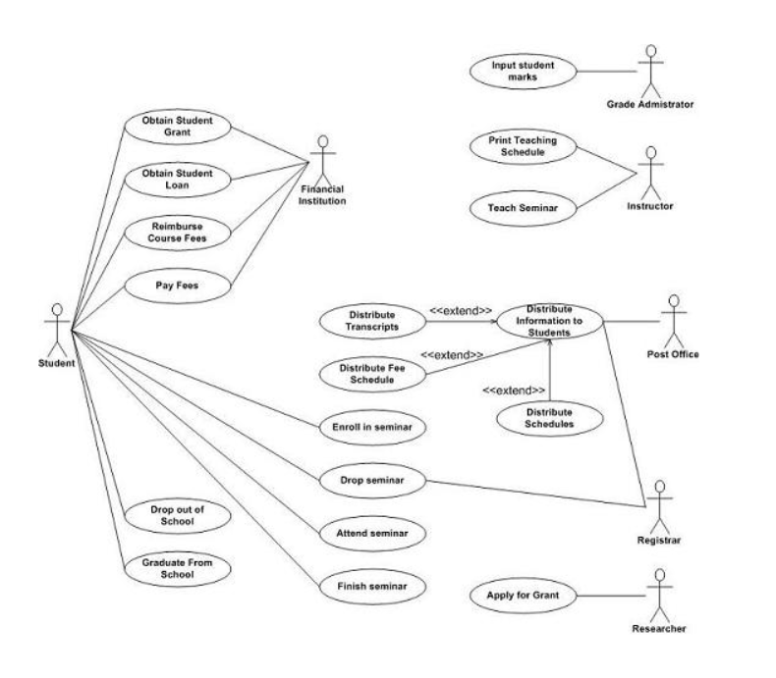

Slide 53
Activity 3:
Provide a SRS document
From the requirements document, ask practitioners to come up with
Category of requirements (Functional, non functional)
Missing requirements or requirements which require clarifications
Notes:
Approximate Duration: 5 minutes
What to cover:
Share the activity guide with the class.
Say that this activity will be performed individually.
Tell the learners to follow the steps
Go around the class to support the participants.
Category of requirements
Functional requirements ( Learners will create each one as a testable requirement). For example, in login page 1. User Name field allows characters to be entered. 2. User name field does not allow special characters.
All requirements under Section 3 fall under this
Non Functional ( For example, the site must download in less than 8 seconds)
Requirements under section 4 fall under this
Performance, usability, etc
Missing Requirements
About Me Page
1. No mention of what needs to be entered in “Other” Section
2. Section – Contact Details – No mention of what needs is the purpose of communication and what will the types to select.

Slide 54


Slide 55
Notes:
Approximate Duration:
What to cover:
Key takeaways:
You have reached the end of this module. You should now be able to list the steps to:

